Slide 1
Welcome to the new
Project

Slide 2
What we offer
Support for children and young people
Support for families
Training and learning

Slide 3
New projects
The Deafness Resource Centre is constantly seeking new ways to engaging children, young and families.
Through a new lottery funded project “I CAN” can develop new projects working across Merseyside to support people of all ages who experience deafness and hearing loss.
The project is aimed at supporting families from the point of diagnosis and throughout their journey by providing impartial information and guidance on issues relating to a range of situations.

Slide 4
What is the
Project?
The I CAN Project is available to people of
all ages who experience deafness
Working across Merseyside, the I CAN project provides:
Fun and engaging activities to support children and young people
A range of services to support the whole family
A total communication approach

Slide 5
The Deafness Resource Centre offers a wide range of support services for children and young people which may include:
Youth clubs
Role models
Peer mentors
Youth residentials
Work experience
Children’s play activities

Slide 6
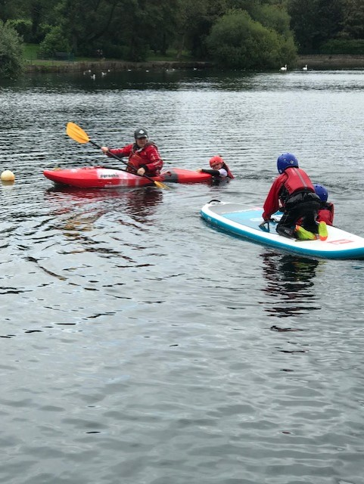
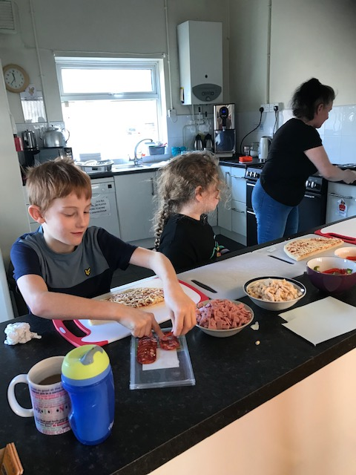
Youth Clubs
Social groups for young people from age 10 to 18 years.
The project is led by young people allowing them to decide what activities they would like to take part in.
Young people who take part in the project can form new friendships and increase their confidence, motivation and self-esteem.

Slide 7
Buddies, role models and peer mentoring
Work experience
This project provides peer mentors and role models to children and young people accessing support through the Deafness Resource Centre.
Young people provide support to their peers, sharing their experiences about their own journeys, discussing boundaries and achievements. Being a peer mentor provides the opportunity to develop their own skills and experiences/
The Deafness Resource Centre offers work experience placements for young people. Roles may include administration, running groups and interacting with young people.
This gives young people an insight into a work environment and allows young people to build and develop their skills and experiences.

Slide 8
Youth residentials
Children’s play activities
Our children’s activities are varied and can include role play, games, arts and crafts and activities that improve and develop physical and emotional wellbeing. All activities offer a total communication approach.
These sessions are family orientated, inclusive of all family members.
Residentials provide an annual team building activity for young people engaging in Deafness Resource Centre services.
This activity allows young people the opportunity to face their fears, reach new goals and increase their skills and confidence.

Slide 9
The Deafness Resource Centre offers a wide range of support services for families:
One on One support
Family sign sessions
Happy Hands
Social sessions

Slide 10
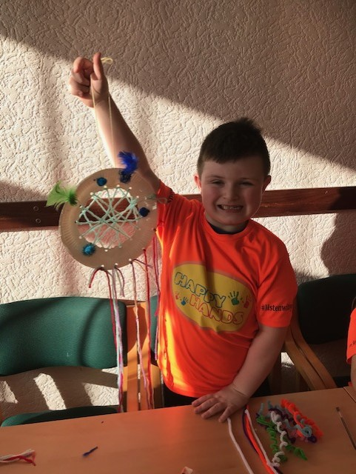
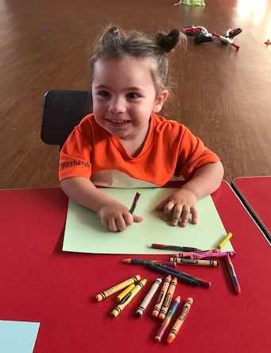
Happy Hands
Happy Hands is a non-profit organisation that is parents led.
Happy Hands is affiliated to the Deafness Resource Centre and the Nation Deaf Children’s Society run by parents and volunteers.
Happy Hands runs weekly sessions which include breakfast/lunch, themed sessions, arts, crafts and various activities.
These sessions incorporate British Sign Language to ensure sessions are fully inclusive.

Slide 11
Social sessions
One to One support
We provide one to one support to children, young people and families. Our support can include helping parents with EHCP and DLA/PIP forms, attending meetings as an advocate or supporting FAM, EHAT, TAF, EHCP review meetings plus much more.
We will also support parents seeking an appropriate schools and can attend meetings with school to ensure everything is in place for the child.
Social sessions can be delivered in many formats with aims to provide informal support to families we are supporting.
These can be in the form of drop in coffee mornings, BSL social groups for people attending the BSL courses providing an opportunity to practice their BSL, as well as fun evening get togethers and fundraising activities.

Slide 12
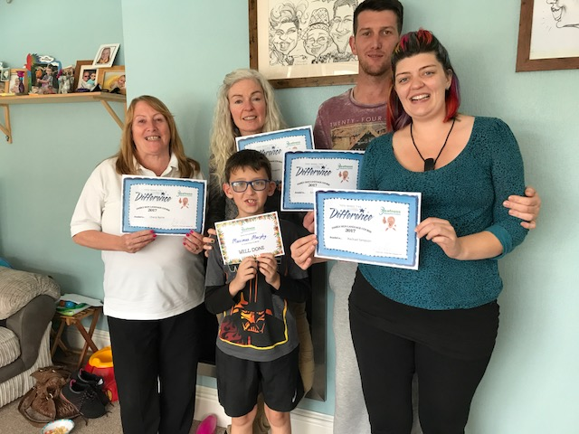
Family Sign
Family sign is a six-week course consisting of weekly sessions to learn basic British Sign language.
These sessions are offered to families and carers of Deaf children free of charge and any family members are welcome to join in. These can be face to face or pre-recorded and sent to the family members.
These sessions are always well received and can be a lot of fun as well as very informative.

Slide 13
Deaf awareness sessions
The Deafness Resource Centre also offers various learning and training opportunities:
Deaf awareness sessions are delivered throughout the year by staff working for the Deafness Resource Centre, these are available to anyone wanting to improve their knowledge and awareness.
Requests to deliver sessions come from all sources including schools, supermarkets, Local Authority, and social housing providers.
The sessions are tailored to suit the organisation and can vary from one hour to half day sessions.
The deaf awareness sessions offer an element of basic BSL, are fun and informative.
BSL
Deafness Resource Centre runs Level One and level two BSL courses these are an accredited course and generally run for around 26 weeks with 2-3 hour weekly.

Slide 14
Get in touch for more information or to make a referral
Phone: 01744 23887
Email: ICAN@deafnessresourcecentre.org
Deafness Resource Centre | 32-40 Dentons Green Lane | St Helens | WA10 2BQ

