Slide 1

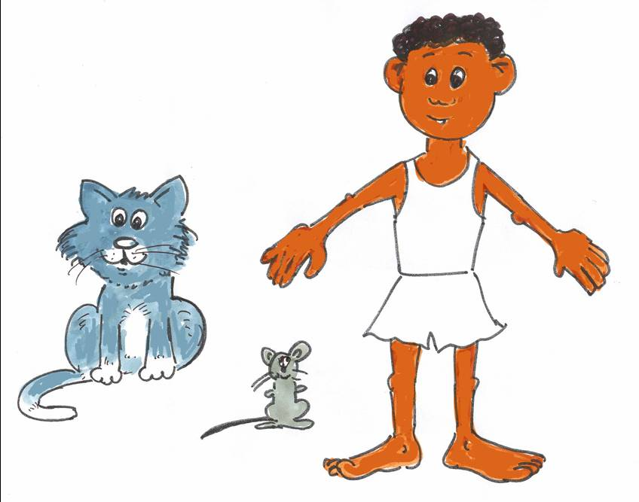
My Body
Seema Book 9

Slide 2
This book practises:
Names of body parts
My name is …
I have a …
I have two …

Slide 3
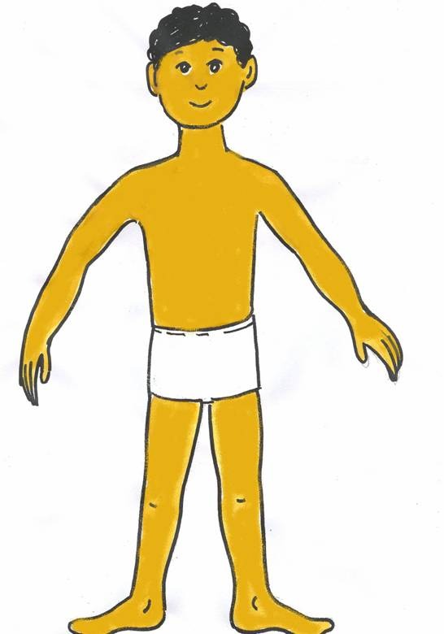
My name is Adam. I am a boy.

Slide 4
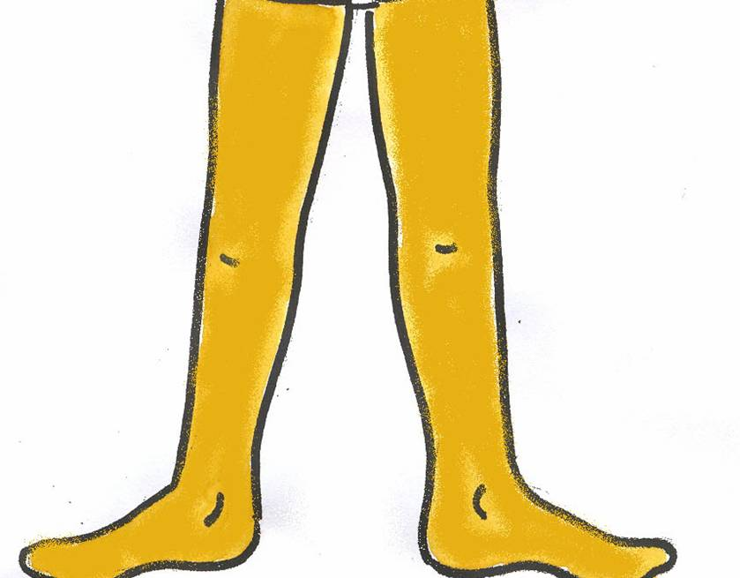
I have two legs. My legs are brown.

Slide 5
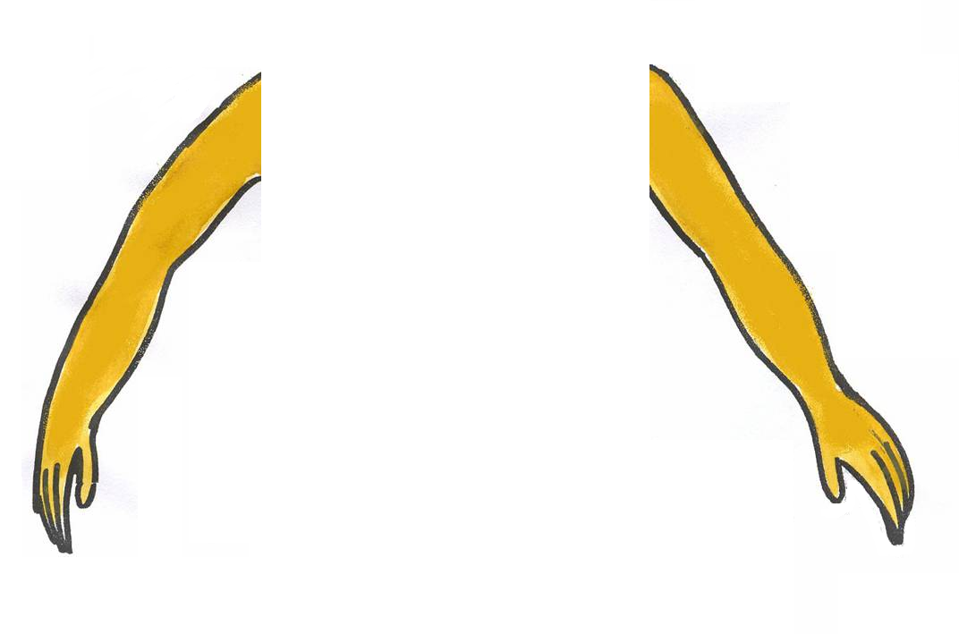
I have two arms. My arms are brown.

Slide 6
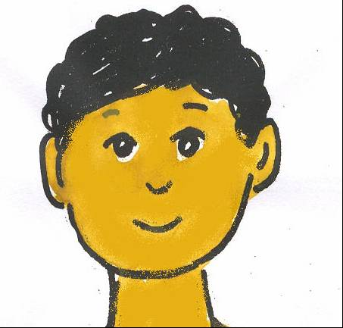
I have a head. I have a nose. I have a mouth.
I have two eyes. I have two ears. My ears are brown.
I have hair. My hair is black.

Slide 7
I have a stomach.

Slide 8
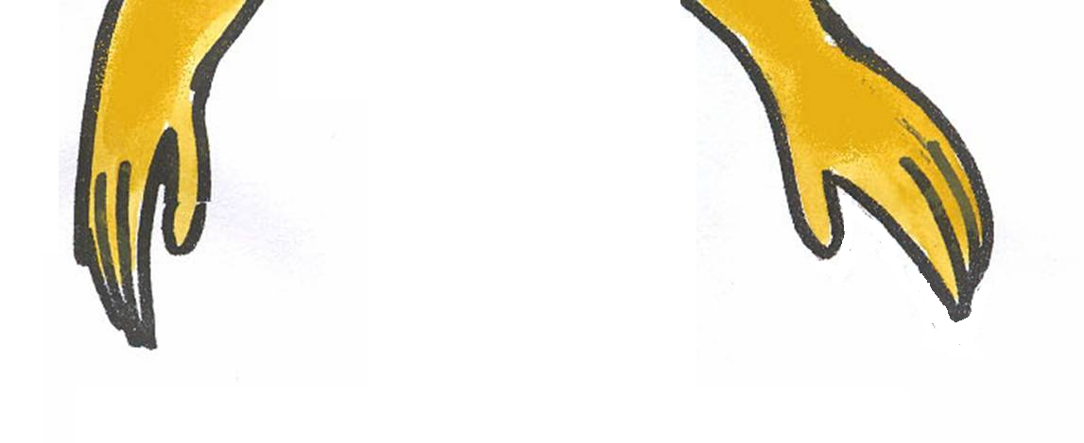
I have two hands. My hands are brown.

Slide 9
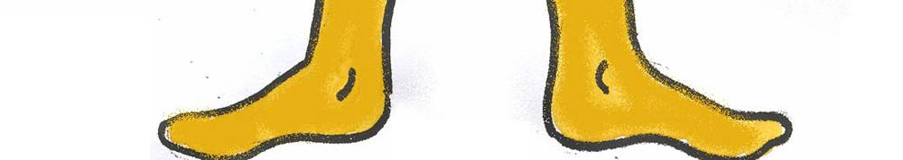
I have two feet. My feet are brown.

Slide 10
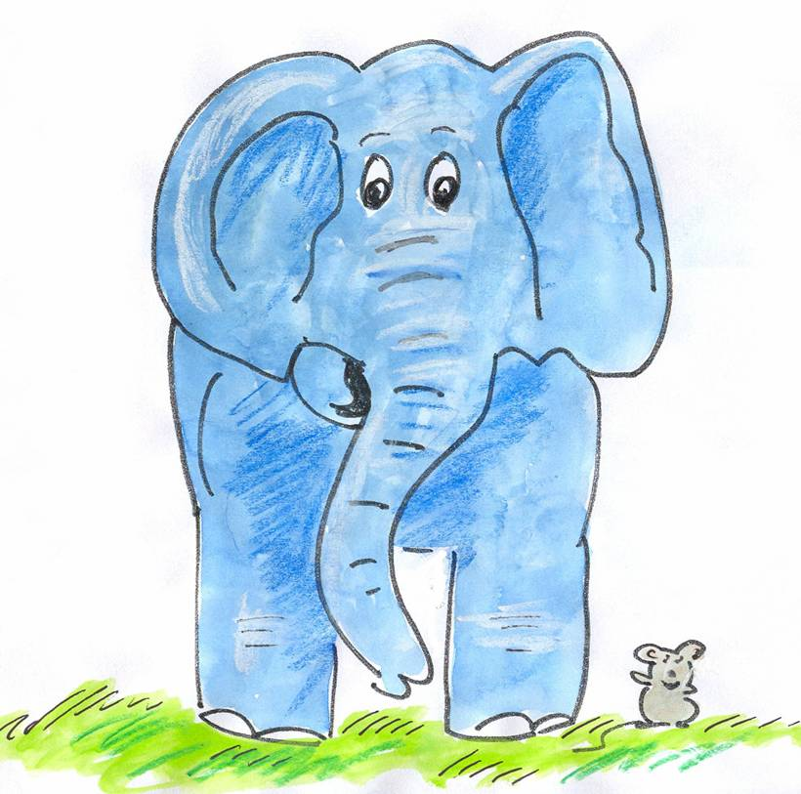
My name is Nelly.
I am an elephant.
I have two blue ears and blue legs.
My name is Seema.
I am a mouse.
I have grey ears and grey arms.

Slide 11
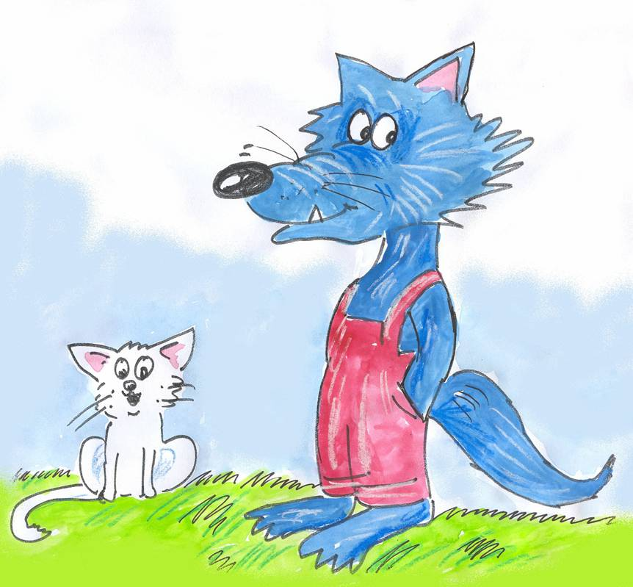
My name is Billy.
I am a white cat.
I have a white tail and a white nose.
I have pink ears.
My name is Wolfy.
I am a big wolf.
I have a blue tail and a black nose.
I have two blue feet.

Slide 12
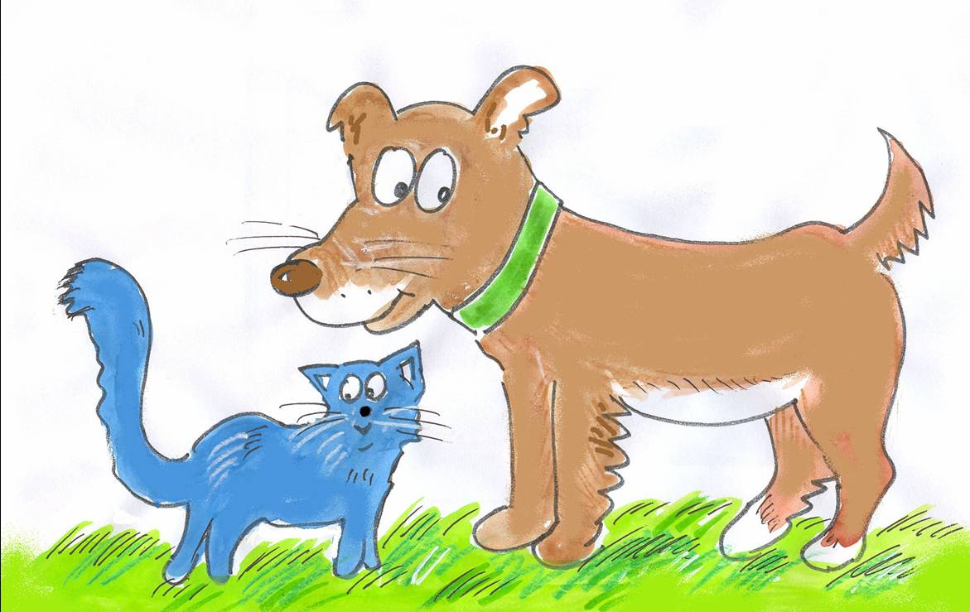
I am a cat.
I have a blue tail and a black nose.
I have a blue stomach.
I am a dog.
I have a brown tail and a brown nose.
I have a white stomach and brown legs.

Slide 13
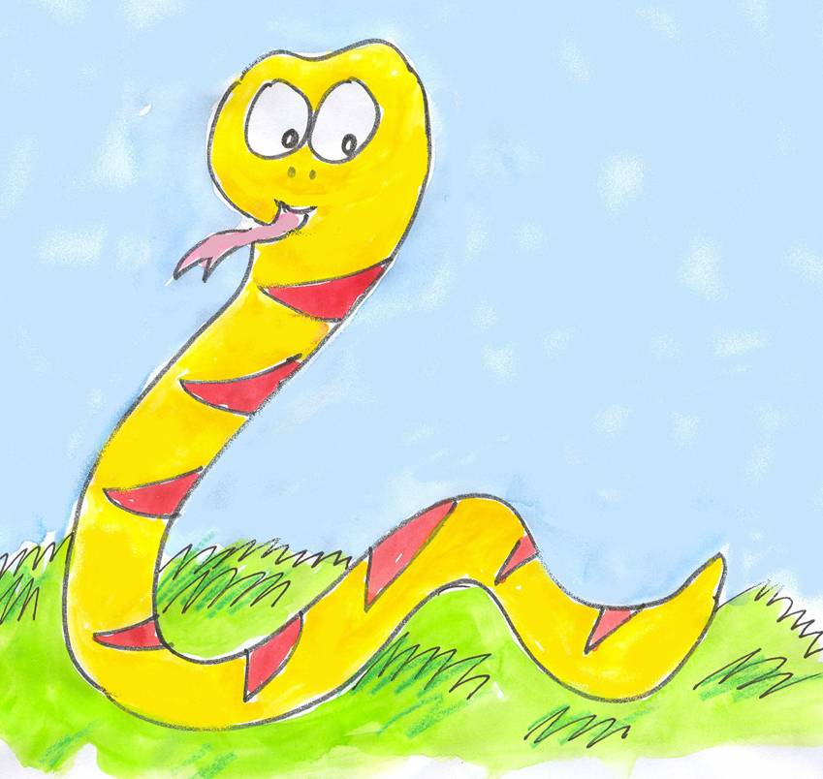
I am a snake.
I have a yellow head.
I have no arms and no legs.
I have a yellow tail and a yellow stomach.
I have a pink tongue.

Slide 14
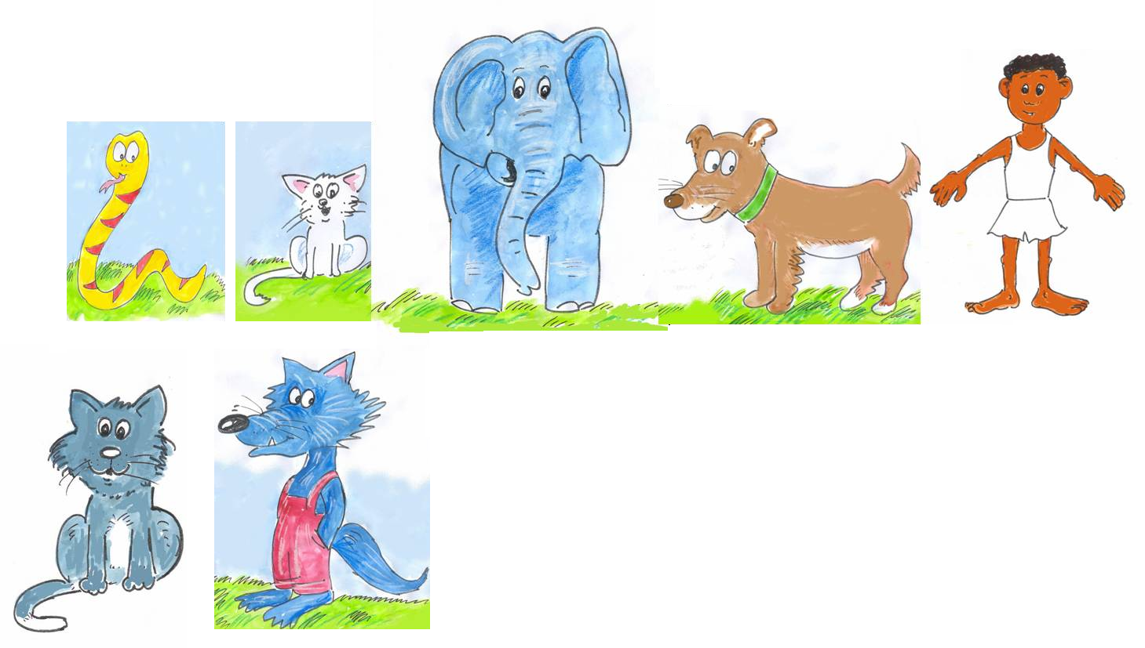
I have a black nose and a blue tail.
I have a brown nose and a brown tail.
I have a white nose and a blue and white tail.
I have a brown nose and brown hands.
I have a white tail and pink ears.
I have no arms and a yellow tail.
I have blue ears and blue legs.

Slide 15
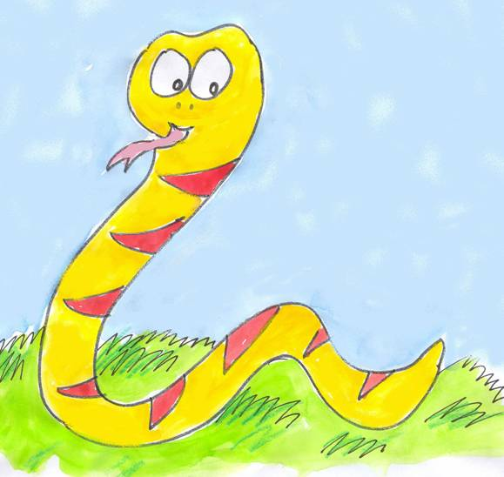
My
name
Adam.
Billy.
Seema.
Billy.
is
boy.
cat.
dog.
snake.
I
am
a
black
blue
yellow
red
pink
brown
black
blue
yellow
red
pink
brown
eyes. ears. nose. mouth. hair. tail. feet.
eyes ears nose mouthhair tail feet
a
two
I have
a
two
and

